Slide 1
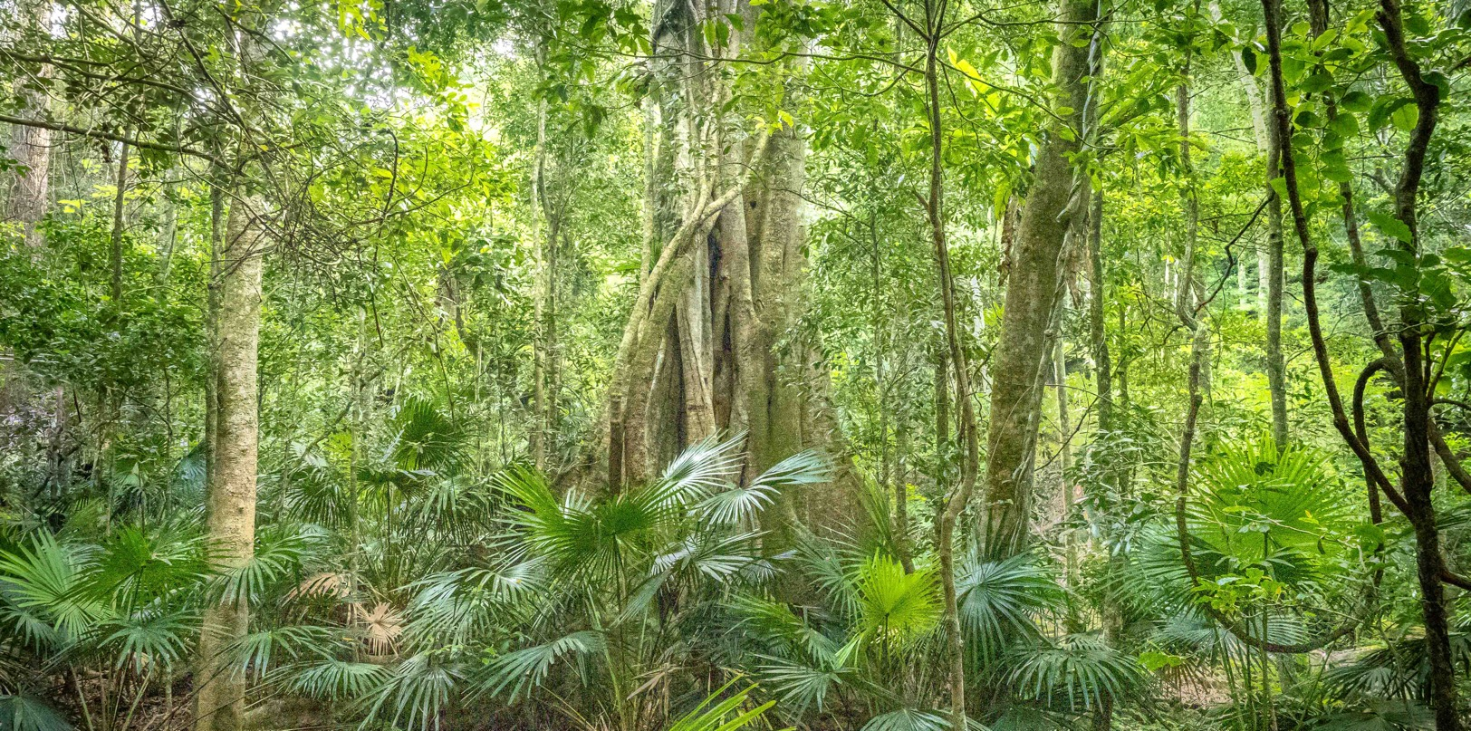
We love Aussie plants
Knowing growing conserving
Strategy 2021 - 2026

Slide 2
Stocktake
Opportunities
Good foundation to build on – loyal members, solid operations, 18 local groups
Growing community interest in native plants
Increase in membership in 2020
Demand for learning
Money in the bank
Deep knowledge of members
Grow plants
Biennial conference in Sept 2022
Challenges
Lose nearly half our members in years 1 and 2 – member care essential
Not systematically focusing on conservation
Not systematically creating learning and capturing knowledge
Aging membership and volunteers and some groups are struggling with resources
Climate change, weeds, development, clearing – all major threats to plants and biodiversity

Slide 3
Strategy – the next 5 years
We love Aussie plants
Knowing, growing, conserving
1. Grow natives in gardens
2. Conserve native plants and places
3. Spread the word
Major plant sales
Grants to DGs for propagation and development
Open gardens
Interest group for small gardens
Support members’ conservation activities
Regeneration Interest group
4. Improve how we do things
Clean up constitution
Improve member care
Improve marketing and promotion
Biennial Conference
Program on online and face to face workshops
Improve DG toolkit
Build partnerships to support conservation
Modernise AP journal
HOW
More native plants in gardens
More native plants conserved
More knowledge about native plants
Members supported
OUTCOMES

Slide 4
Implementation timeline
Strategy | Initiative | July – Dec 2021 | Jan to June 2022 | July to Dec 2022 | 2023
1. Grow natives in gardens | 1a. Major plant sales | Scope for 2022 Conference |  | Hold sale at Conf | Hold sale in Sept 2023
 | 1b. Grants to DGs for propagation and development | Scope out and launch
 | 1c. Open gardens | Develop framework | First open gardens in autumn | Second open gardens in spring | Plan for 2023 open gardens
 | 1d. Interest groups for small gardens | Develop a brief and launch in Sept |  |  | 2.
2. Conserve native plants and places | 2a. Support and promote members’ own conservation activities | Research member activities and promote
 | 2b. Build partnerships to support conservation projects | Research partnership options | Develop partnerships
 | 2c. Regeneration Interest group | Develop a brief and launch in October
3. Spread the word | 3a. Biennial Conference |  |  | Hold Conference
 | 3b. Program on online and face to face workshops | Develop scope and find resources to develop/manage | Launch June 2022 | Continue development of programs
4. Improve how we do things | 4a. Clean up constitution |  |  |  | Identify issues and way forward
 | 4b. Improve member care | Identify high priority areas (Sept) and start | Further rollouts
 | 4c. Improve DG toolkit | Develop suggestions and prioritise
 | 4d. Modernise AP journal |  |  | Scope out and seek assistance | Undertake work and launch Dec
 | 4e. Improve marketing and promotion | Plan approach by Dec

Slide 5
Strategy 2021 – 2026: Our audiences extend beyond members to the broader community
Our purpose:
Our country, our plants. Stand up for native plants!
Community
Members
Volunteers and leaders
Care about the environment, bushfires, fauna, native plants, sustainability, healthy living
Looking for information and someone to trust
May wish to volunteer on ad hoc projects
May present opportunities for partnership and shared learning
As above +
Passion for native plants
Making a difference, having impact
A meaningful relationship with APS NSW
Systematic learning
Like-minded people to engage with
Sharing knowledge and expertise
As above +
Having impact
Keeping people engaged
Maintaining balance

Slide 6
1. Grow native plants in gardens
Initiatives | What | When/How
Conduct major plant sales | DG and state work together with focus on hard to find plants All groups can participate + favourite nurseries | Develop as part of Conference and hold in September 2022 Next sale: September 2023
Offer grants from Bequest Fund to DGs | Support propagation and growth activities Focus on hard to source plants | Agree criteria and approach and publicise – Aug 2021 Launch Sept 2021
Conduct series of open gardens, based around district groups and/or regions | Work with DGs to identify 3 – 5 gardens in a region to open Support gardeners as required Link with gatherings and other events | Develop framework by Dec 2021 Hold in Autumn 2022 and Autumn and Spring 2023
Set up interest group for small spaces, and link to ANPSA study group | A lot of interest in gardens in small spaces in urban areas and higher density housing Opportunity to build more knowledge to share with people across APS in mostly virtual format | Develop brief and program of activities by Oct 2021 Publicise and launch Nov 2021

Slide 7
2. Conserve native plants and places
Initiatives | What | When/How
Support and promote members’ own conservation activities | Members are already doing a lot in conservation and there is an opportunity to build on that activity and relationships | Research what members are doing already and the relationships they have and where there is an opportunity to support them – Dec 2021 Start promotion through Sept – Dec 2021 and beyond
Build partnerships to support conservation at both state and DG levels | A lot of NFPs and organisations focus on conservation and present partnership opportunities for us e.g. NPWS for Save our Species, NPA for advocacy, NCC, other organisations for specific projects. There may be opportunities to fund submissions and support revegetation and regeneration projects | July – Dec 2021 to gather info on potential partners By June 2022 – decide on partnerships and progress
Set up Regen interest group and hold 2021 weekend event in central west on regen | Promote regenerative farming Have such a speaker at the ANPSA conference | Develop brief by Sept 2021 Launch by Oct 2021 as part of trip out west

Slide 8
3. Spread the word
Initiatives | What | When/how
Run successful 2022 conference in Kiama | Deliver the plan Attract members and visitors Hold market fair with plant sales | Conference 2022
Create a program of online and in person workshops on native plant knowledge and skills | A lot of interest in native plant info but little systematised capturing of the info Develop a set of topics eg – id, propagation, families, how to’s Include different pricing for members Develop the scope and plan Identify resources to assist in developing and managing Link into gatherings and get togethers with skills based workshops | Develop the scope and plan - Sept to Dec Implement – Jan to June 2022 Then continue development

Slide 9
4. Improve how we do things
Initiatives | What | When/How
Clean up the constitution to make it easier to operate | Decide what we want eg more flexible group structures, different board model Seek assistance to complete | Plan for 2023
Improve member care, particularly new members | Develop list of suggestions to share eg exit ivs by DGs, welcome/greeter, free plants Create more opportunities for sharing insights, member packs, visit new members gardens with advice, new member outings | Develop a new member approach – Sept 2021 Start with new member info - Sept 2021 Develop plan for next activities – Dec 2021
Improve DG toolkit | Develop speaker lists and travel policy Share ideas and resources eg presentations, Group email for publicity officers, governance outline, more frequent Pres discussions, group summaries as enewsletter, submission template | Dec 2021 for lists and ideas
Modernise Aust Plants journal | Digitise over time, while retaining printed copies at a cost | Scope what is required by end 2022. Plan approach and implementation by 2023
Improve marketing and promotion | Brochures, social media training, signage | Plan by end 2021

Slide 10
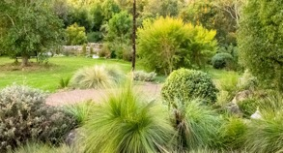
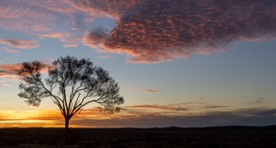
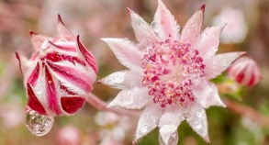
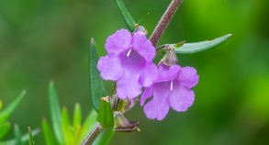
Outcomes and targets – the next 5 years
We love Aussie plants
Knowing, growing, conserving
More native plants in gardens
More native plants conserved
More knowledge about native plants
Members supported
OUTCOMES
3 – 5 regional well attended open gardens
Successful plant sales each year
Small garden IG successful
Partnerships established with conservation organisations
Tangible outcomes in saving species
More vocal and active voice on conservation
Successful Biennial Conference
Training program creating new community and member engagement
10% increase in membership
Retain 70% of new members (1 and 2 years)
2 – 3 interest groups established
Improved member onboarding and care
Better tools for DGs
Breakeven or better
TARGETS

